Slide 1
TransCAD简介
《交通规划》实验

Slide 2
关于交通软件
交通模型-数据-交通软件(Model-Data-Application)
交通模型是出行规律的理论描述形式之一，是抽取了实际问题主要特征、规律的理论概括；
数据是用以标定交通模型的必要元素，它决定了交通模型的实际应用效果。
交通软件隶属于应用层面，是连接理论模型、交通数据和交通网络(工程实践)之间的纽带，是实现各种交通模型应用的必要计算机辅助手段。

Slide 3
常用交通软件
CUBE(TRIPS)
TransCAD
PARAMICS
PTV-Vision
EMME - Multimodal Transport Planning Software2
TranStar
……

Slide 4
交通规划软件的一般功能
网络建模(editor)
  节点、线段的生成、修改、删除、显示，与后台数据库的动态链接，形成不同年份、不同交通方式的网络，不同方案的生成。
  小区划分，小区内经济社会指标统计，现状交通数据(断面交通量、OD交通量)。
交通需求预测
  四阶段法、交通流模拟
  生成交通量、发生与吸引交通量、分布交通量、交通方式划分交通量、交通流分配。
方案评价
  交通量、负荷度、行驶车速、出行距离、断面OD交通量……

Slide 5
About Caliper
Caliper Corporation成立于1983年，总部位于马萨诸塞州牛顿市，是地理信息系统（GIS）和运输软件开发的技术领导者。Caliper也是一家备受推崇的咨询和研发提供商，提供有关定量管理咨询、运输和决策支持系统开发方面专业服务。Caliper 软件产品在 GIS 应用和培训、数据库开发和软件定制方面提供广泛的技术服务支持。
Caliper开发的软件包括
  TransCAD®交通规划软件
  TransModeler®交通模拟软件
  Maptitude®地理信息系统
Notes:
About Caliper
Caliper Corporation, founded in 1983 and headquartered in Newton, MA, is a technology leader in the development of geographic information systems (GIS) and transportation software. Caliper is also a highly regarded consulting and R&D provider offering professional services in quantitative management consulting, transportation, and decision support systems development. Caliper software products are supported with extensive technical services in GIS applications and training, database development and software customization.
Caliper is the developer of TransCAD® Transportation Planning Software, TransModeler® Traffic Simulation Software, and Maptitude® Geographic Information System Software packages.

Slide 6
About TransCAD
TransCAD 是第一个也是唯一一个专为运输专业人员设计的地理信息系统(GIS)，用于存储、显示、管理和分析运输数据。TransCAD 将 GIS 和交通建模功能结合在一个集成平台中，提供任何其他软件包都无法比拟的功能。TransCAD可用于任何比例或细节水平的所有运输方式。
  强大的 GIS 引擎，具有专门用于运输的扩展
  专为交通运输应用设计的地图处理、可视化和分析工具
  用于路线规划、出行需求预测、公共交通、物流、站点位置和区域管理的应用模块
Notes:
TransCAD is the first and only Geographic Information System (GIS) designed specifically for use by transportation professionals to store, display, manage, and analyze transportation data. TransCAD combines GIS and transportation modeling capabilities in a single integrated platform, providing capabilities that are unmatched by any other package. TransCAD can be used for all modes of transportation, at any scale or level of detail. TransCAD provides:
A powerful GIS engine with special extensions for transportation
Mapping, visualization, and analysis tools designed for transportation applications
Application modules for routing, travel demand forecasting, public transit, logistics, site location, and territory management

Slide 7
Mapping and Data Visualization
借助 TransCAD，您可以使用数十种专题制图样式和选项、无限颜色以及完全可缩放的线样式和地图符号创建高质量的地图输出。只需单击几下鼠标，MapWizard® 自动制图技术即可帮助您创建颜色和图案编码地图、点密度地图、比例符号地图以及具有集成饼图和条形图的地图。TransCAD还为运输应用提供专门的测绘功能：
  自动显示单行道
  根据地图比例进行调整的动态地图标注
  内置高速公路盾牌，可生成出版质量的地图
  并排显示重叠路线的路线系统地图，以提高可见性
  显示区域到区域流的期望线图
其他工具可让您可视化无法使用传统 GIS 显示的数据：
  绘制交通流和转向运动的交叉口
  描绘设施特征及其沿路径变化的带状图
  用于编辑地理要素以及定义转弯限制和延迟的交互式工具
Notes:
With TransCAD, you can create high-quality map output using dozens of thematic mapping styles and options, unlimited colors, and fully-scalable line styles and TrueType map symbols. With a few clicks of the mouse, MapWizard® automatic mapping technology helps you create color and pattern coded maps, dot-density maps, scaled-symbol maps, and maps with integrated pie charts and bar charts. TransCAD also provides specialized mapping functions for transportation applications:
Automatic display of one-way streets
Dynamic map labeling that adjusts to the scale of the map
Built-in highway shields that result in maps of publication quality
Route system maps that show overlapping routes side-by-side for greater visibility
Desire line maps that show region-to-region flows
Additional tools let you visualize data that cannot be displayed using a conventional GIS:
Intersection diagrams that illustrate flows and turning movements
Strip charts that depict facility characteristics and their variation along a route
Interactive tools for editing geographic features and for defining turn restrictions and delays

Slide 8
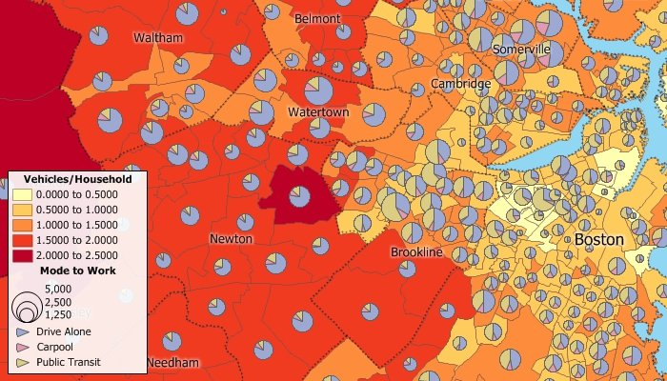
多姿多彩的主题展示
Create color, pattern, chart, dot-density, and scaled-symbol thematic maps

Slide 9
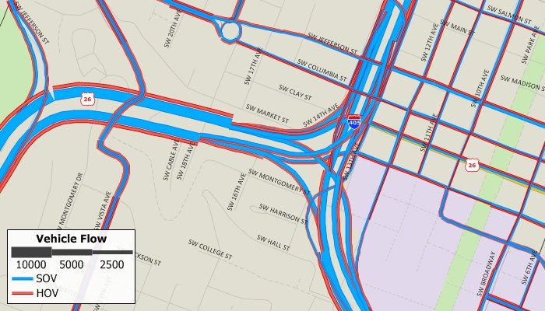
多种路段交通量展示
Create multi-variable scaled-symbol themes on links

Slide 10
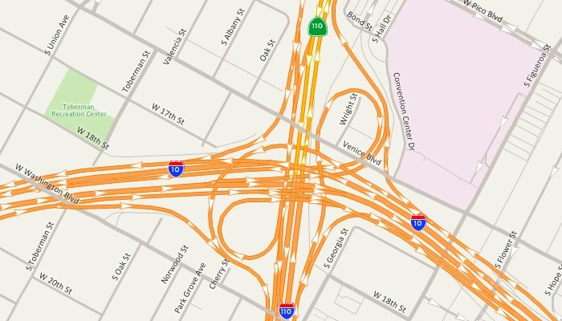
丰富的路段展示手段
Display one-way streets and use dozens of line styles and highway shields

Slide 11
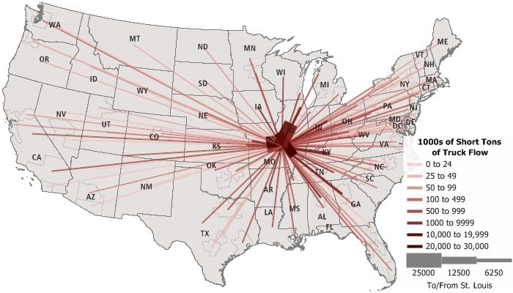
期望线
Use desire lines to illustrate O-D flows, commodity flows, and other matrix data

Slide 12
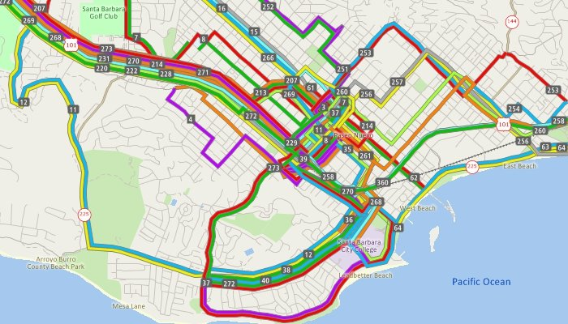
公交展示
Display transit routes side-by-side over the links that they traverse

Slide 13
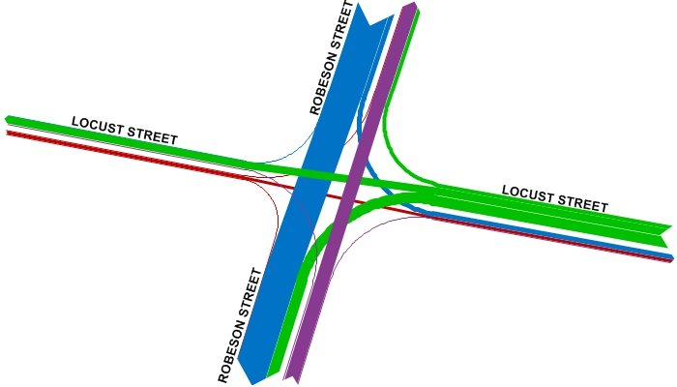
交叉口转向流量展示
Show turning movement data with intersection diagrams

Slide 14
尖端的地理和交通分析工具

Slide 15
Geographic Analysis 地理信息分析
挖掘隐藏在数据中的趋势和信息
  使用 GIS 的最佳理由之一是挖掘和分析数据的地理组成部分。
  使用地理工具，您可以在地图要素周围创建波段（缓冲区）、创建选区、定义影响区域、执行表面分析以及创建密度格网。
  TransCAD还可以轻松叠加和聚合数据以及计算统计数据。
Notes:
Unearth the trends and information hidden in your data
One of the best reasons to use a GIS is to unearth and analyze the geographic components of your data. Using geographic tools, you can create bands (buffers) around map features, create districts, define areas of influence, perform surface analysis, and create density grids. TransCAD also makes it easy to overlay and aggregate data and calculate statistics.

Slide 16
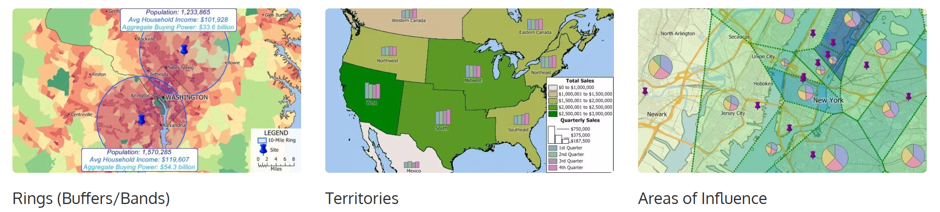
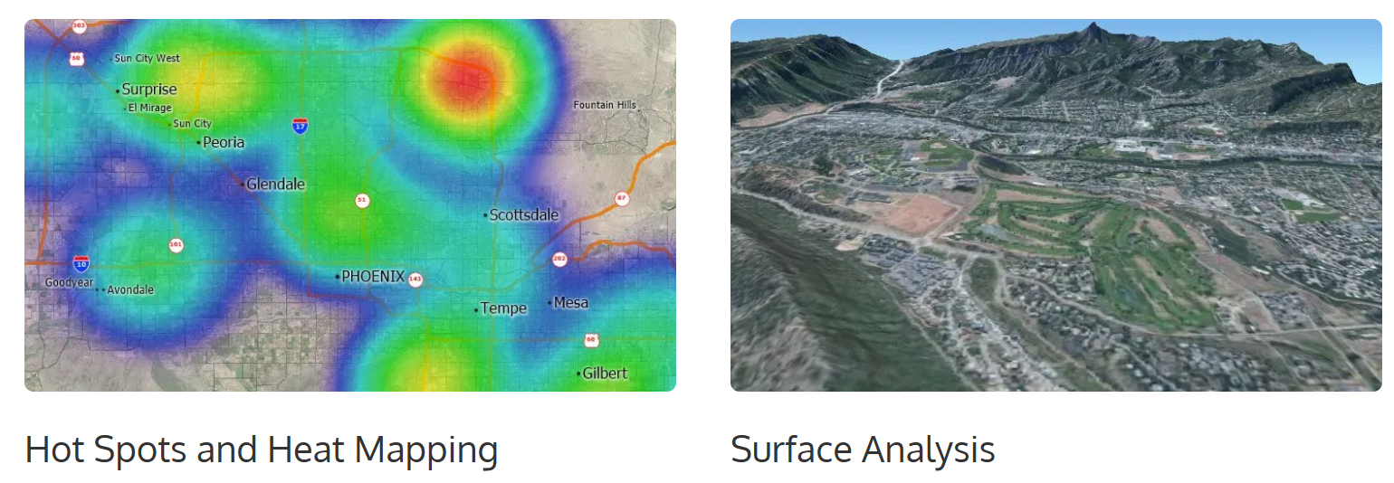
挖掘隐藏在数据中的趋势和信息

Slide 17
Transportation Application Modules
适用于各类运输应用的综合解决方案。
  TransCAD是唯一将GIS与需求建模和物流功能完全集成的软件。与其他GIS软件产品不同，TransCAD中的应用程序模块与GIS功能完全集成，以提高性能和易用性。TransCAD还可以解决几乎任何规模的问题，这使得TransCAD成为许多类型运输应用的理想选择，包括：
    网络分析
    交通规划和出行需求建模
    公共交通分析
    车辆路线规划和物流分析
    区域管理和站点位置建模
Notes:
A comprehensive solution for all types of transportation applications
TransCAD is the only software package that fully integrates GIS with demand modeling and logistics functionality. Unlike other GIS software products, application modules in TransCAD are fully integrated with GIS functions for improved performance and ease of use. TransCAD can also solve problems of virtually any size. This makes TransCAD ideal for many types of transportation applications including:
Network Analysis
Transportation Planning and Travel Demand Modeling
Transit Analysis
Vehicle Routing and Logistics
Territory Management and Site Location Modeling

Slide 18
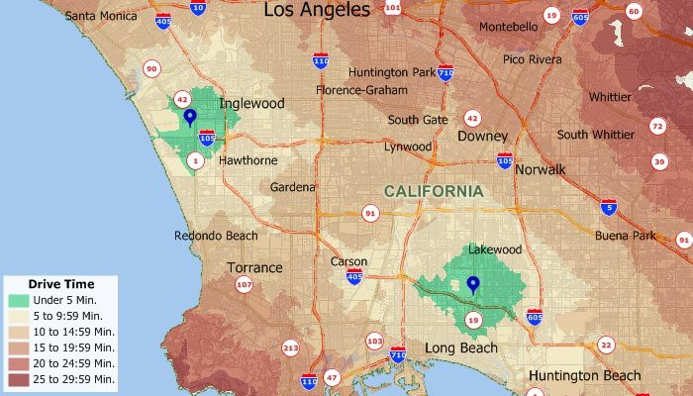
Network Analysis
网络分析模型用于解决多种类型的交通网络问题：
  最短路径模块可用于在任意数量的起点和任意数量的目的地之间生成具有任意数量的中间点的最短、最快或成本最低的路径。
  网络分区可用于根据可达性创建服务区、执行行驶时间分析或评估可能的设施点位。执行网络分区时，还可以计算从特定位置开始的网络距离或行驶时间。
  旅行商问题模型构建高效的路径，访问网络上任意数量的点。
Notes:
Network analysis models are used to solve many types of transportation network problems:
Shortest path routines can be used to generate the shortest, fastest, or least-costly route between any number of origins and any number of destinations, with any number of intermediate points.
Network partitioning can be used to create service districts based on accessibility, perform drive-time analysis, or evaluate possible facility locations. When you perform network partitioning, you can also calculate the network distance or travel time from specific locations.
Traveling salesman models construct efficient tours that visit any number of points on a network.

Slide 19
交通规划与出行需求分析
Trip Generation/Production
Trip Attraction
Trip Distribution
Mode Split
P-A to O-D and Time of Day
Traffic Assignment
Advanced Highway Assignment
Notes:
Trip Generation/Production models included with TransCAD estimate the number of trips, by purpose, that are produced or originate in each zone of a study area.
Trip Attraction models predict the number of trips attracted to each zone or to a particular land use.
Trip Balancing methods are provided so that the number of attractions equals the number of productions.
Trip Distribution models are used to predict the spatial pattern of trips or other flows between origins and destinations.
Mode Split models are used to analyze and predict the choices that individuals or groups of individuals make in selecting the transportation modes that are used for particular types of trips.
P-A to O-D and Time of Day tools enable you to convert productions and attractions to origins and destinations, decompose a 24-hour trip table matrix into hourly trip tables, convert person trips to vehicle trips, and apply peak hour factors.
Traffic Assignment models estimate the flow of traffic on a network and allow you to establish the traffic flow patterns and analyze congestion points. TransCAD provides a full complement of traffic assignment procedures that are used for modeling urban traffic. These procedures include numerous variants that are tailored for modeling transit, as well as intercity passenger and freight traffic by rail, road, air, and barge.
Advanced Highway Assignment procedures included with TransCAD allow for generalized-cost traffic assignment, HOV assignment, multimode vehicle assignment, multiple user class traffic assignment, combined trip distribution/assignment, and assignment with volume-dependent turning delays and signal optimization.

Slide 20
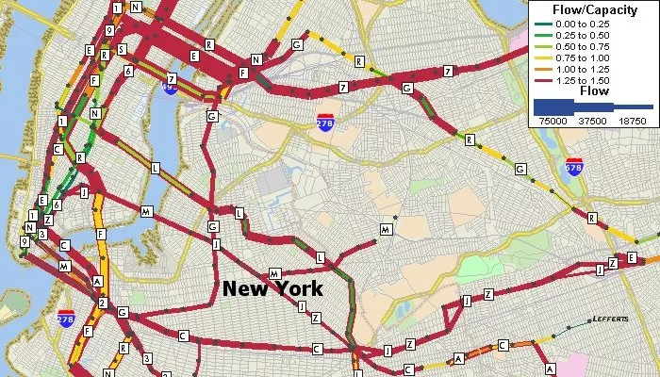
Transit Analysis
TransCAD还具有用于创建和使用交通网络的特殊工具和程序。公交票价可以指定为固定票价或区域票价。使用公交网络和票价结构，您可以解决最短路径问题并计算公交路径属性（即略读）。您还可以为非机动出行模式提供单独且完全集成的网络。例如，在执行交通网络分析时，可以包括行人链接。
公交网络也可用于执行公交流量分配。您可以估计使用交通网络中link的乘客数量作为公交服务水平的函数。这些模型生成link级别和汇总乘客量统计信息。TransCAD包括一系列复杂的公交网络分配程序。
TransCAD是唯一具有公共交通特定扩展的GIS。TransCAD可以对复杂的公交系统进行数据管理，并在客户信息系统，调度和营销方面具有应用。
Notes:
TransCAD also has special tools and procedures for creating and working with transit networks. Transit fares can be specified as either flat or zonal. Using transit networks and fare structures, you can solve shortest path problems and calculate transit path attributes (i.e. skims). You can also have separate and fully integrated networks for non-motorized travel modes. For example, you can include pedestrian links when doing transit network analysis.
Transit networks can also be used for performing transit assignment. You can estimate the number of passengers that utilize links in a transit network as a function of transit level of service. These models produce link level and aggregate ridership statistics. TransCAD includes an array of sophisticated transit network assignment procedures.
TransCAD is the only GIS with specific extensions for public transit. TransCAD can perform data management for complex transit systems and has applications in customer information systems, scheduling, and marketing.

Slide 21
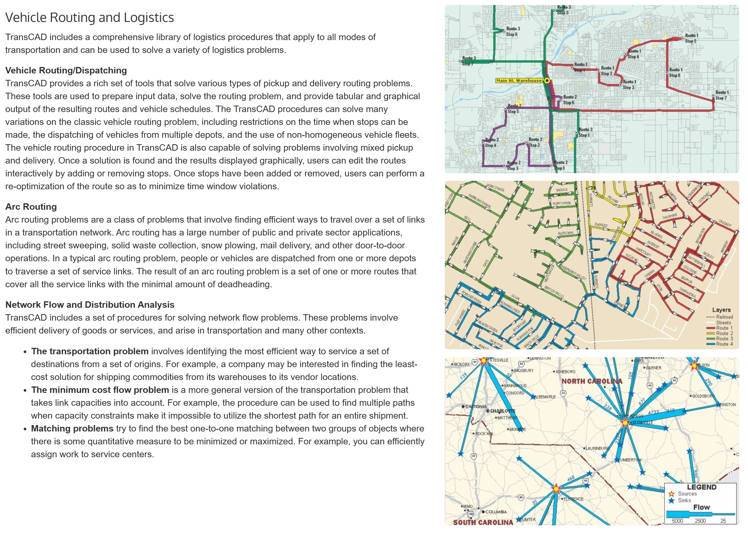

Slide 22
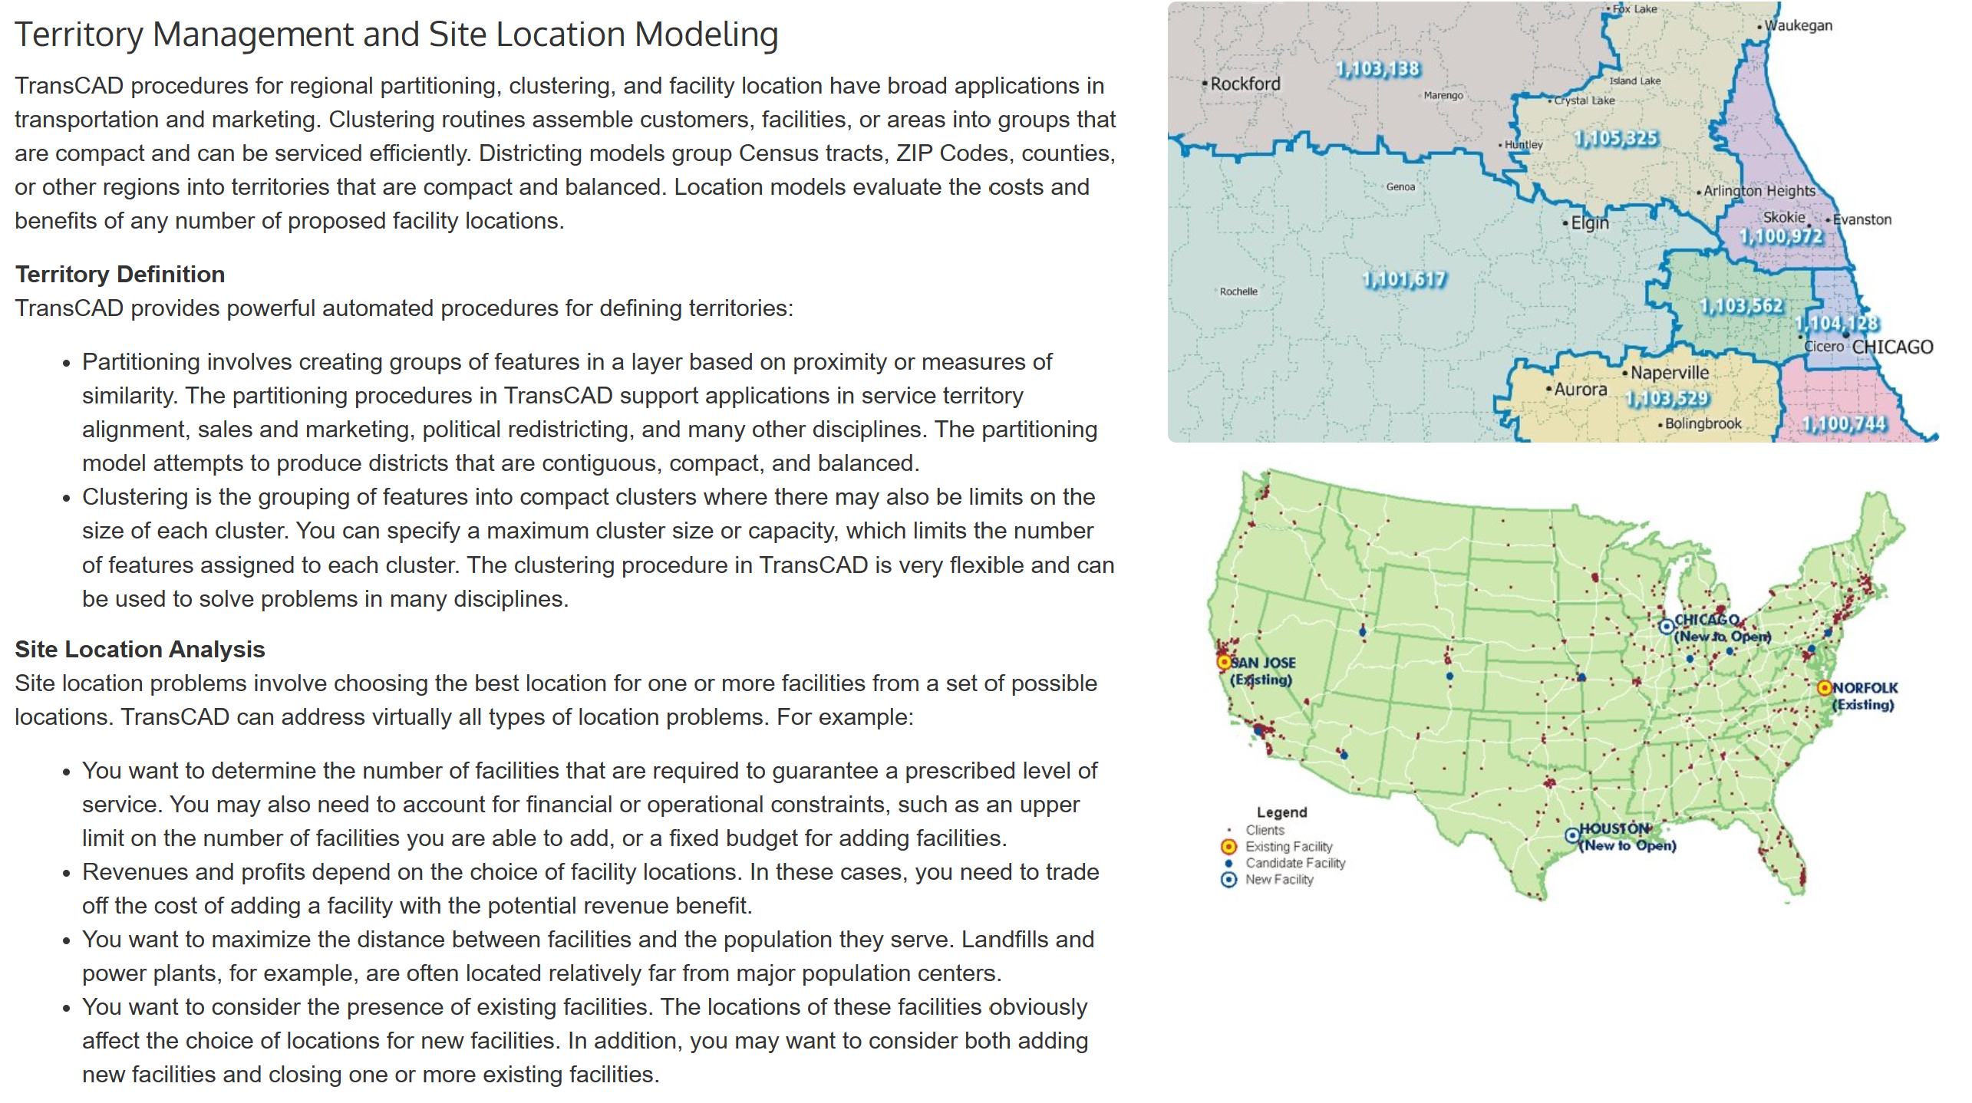

Slide 23
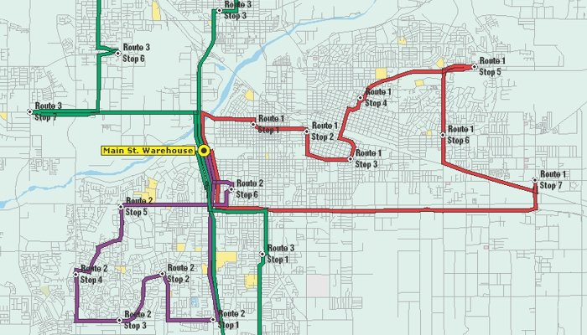
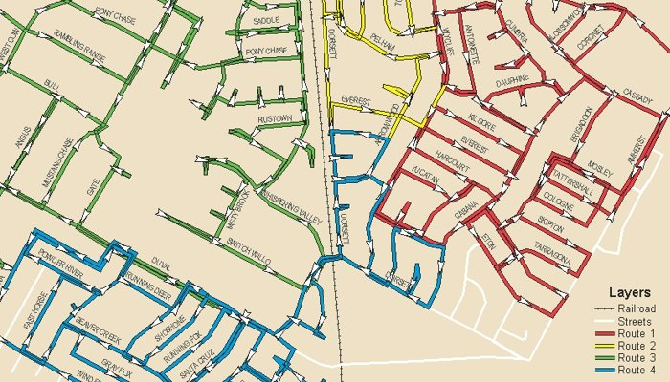
Vehicle Routing and Logistics
弧路径问题 Arc Routing
Vehicle Routing/Dispatching

Slide 24
Network Flow and Distribution Analysis
TransCAD includes a set of procedures for solving network flow problems. These problems involve efficient delivery of goods or services, and arise in transportation and many other contexts.
  The transportation problem involves identifying the most efficient way to service a set of destinations from a set of origins. For example, a company may be interested in finding the least-cost solution for shipping commodities from its warehouses to its vendor locations.
  The minimum cost flow problem is a more general version of the transportation problem that takes link capacities into account. For example, the procedure can be used to find multiple paths when capacity constraints make it impossible to utilize the shortest path for an entire shipment.
  Matching problems try to find the best one-to-one matching between two groups of objects where there is some quantitative measure to be minimized or maximized. For example, you can efficiently assign work to service centers.

Slide 25
TransCAD的建模功能
TransCAD Modeling Capabilities
  TransCAD includes comprehensive tools for trip generation, trip distribution, mode split modeling, traffic assignment, and all related matrix and network processes. TransCAD includes all of the traditional 4-step models and significant variants, quick response models with reduced data requirements, and advanced disaggregate demand models. Caliper continually enhances TransCAD to incorporate the most up-to-date methods for demand forecasting.

Slide 26
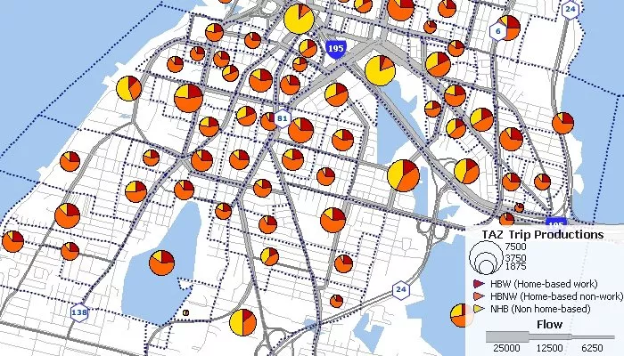
Trip Generation/Production 出行生成
The goal of trip production is to estimate the number of trips, by purpose, that are produced or originate in each zone of a study area. Trip generation is performed by relating frequency of trips to the characteristics of the individuals, of the zone, and of the transportation network.
  Cross-Classification
  Regression Models
  Discrete Choice Models
  Population Synthesis

Slide 27
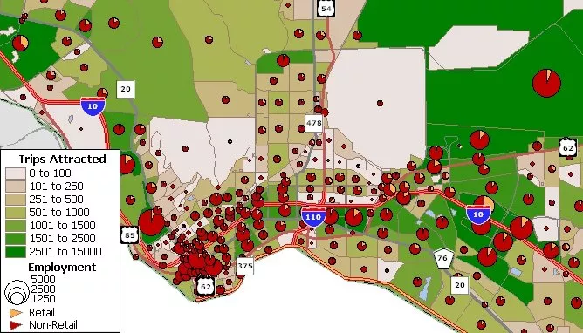
Trip Attraction / Trip Balancing
Trip Attraction
  The goal of Trip Attraction is to predict the number of trips attracted to each zone or to a particular land use. In many ways, estimating attractions is similar to estimating trip productions. Thus, cross-classification, regression, and discrete choice methods can be used to estimate the number of trips attracted to a zone. TransCAD also includes Institute of Transportation Engineers (ITE) trip rate data for calculating trip attraction values for a single land use or mixed land uses.
Trip Balancing
  In trip generation, separate models are used to predict productions and attractions. This invariably leads to a discrepancy between the number of intraregional trips produced in an area and the number of trips attracted to an area. To conserve trips, balancing methods are provided so that the number of attractions equals the number of productions. Trip generation and attraction can be balanced flexibly to productions or attractions or a linear combination thereof.
Notes:
Trip Attraction
The goal of Trip Attraction is to predict the number of trips attracted to each zone or to a particular land use. In many ways, estimating attractions is similar to estimating trip productions. Thus, cross-classification, regression, and discrete choice methods can be used to estimate the number of trips attracted to a zone. TransCAD also includes Institute of Transportation Engineers (ITE) trip rate data for calculating trip attraction values for a single land use or mixed land uses.
Trip Balancing
In trip generation, separate models are used to predict productions and attractions. This invariably leads to a discrepancy between the number of intraregional trips produced in an area and the number of trips attracted to an area. To conserve trips, balancing methods are provided so that the number of attractions equals the number of productions. Trip generation and attraction can be balanced flexibly to productions or attractions or a linear combination thereof.

Slide 28
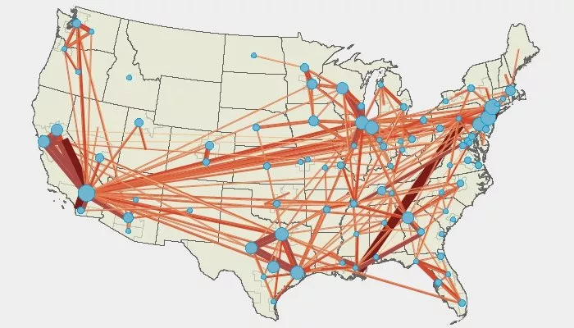
Trip Distribution 出行分布

Slide 29
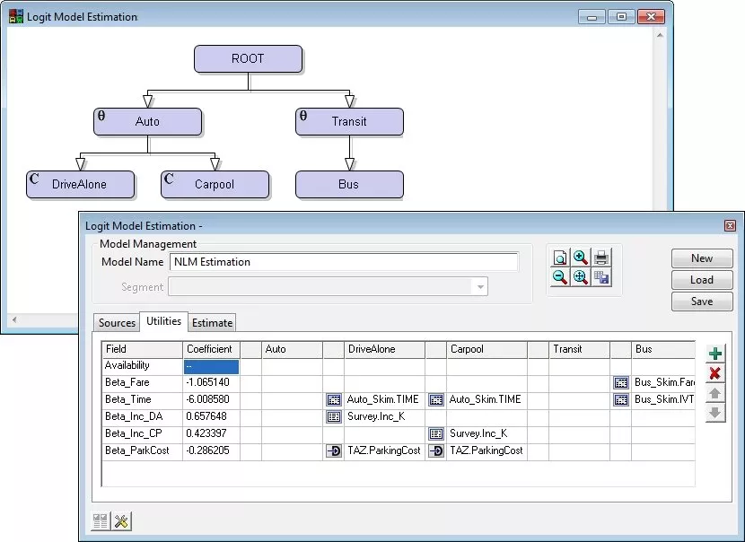
Mode Choice Analysis 出行方式划分

Slide 30
变换功能：P-A to O-D 以及 Time of Days
P-A to O-D and Time of Day Transformations
TransCAD includes comprehensive tools that enable you to:
  Convert productions and attractions to origins and destinations
  Decompose a 24-hour trip table matrix into hourly trip tables
  Convert person trips to vehicle trips
  Apply peak hour factors

Slide 31
先进的交通分配算法确保计算快速且收敛
多模态收费道路交通分配 Multi-modal toll road assignment
起点用户均衡 Origin user equilibrium
基于路径的交通分配Path-based assignment
多点用户均衡 Multi-point equilibrium assignment
交通分布-分配组合分配 Combined distribution-assignment
考虑交通信号和交叉口延误的分配
Assignment with traffic signals and HCM intersection delay
动态交通分配 Dynamic equilibrium traffic assignment
HCM – Highway Capacity Manual

Slide 32
TransCAD——实用道路流量宏观预测方法
规划软件：TransCAD
预测对象：
国家话剧院2010年周边道路流量
主要技术线路
现状OD反推
增长率预测未来OD
交通流分配

Slide 33
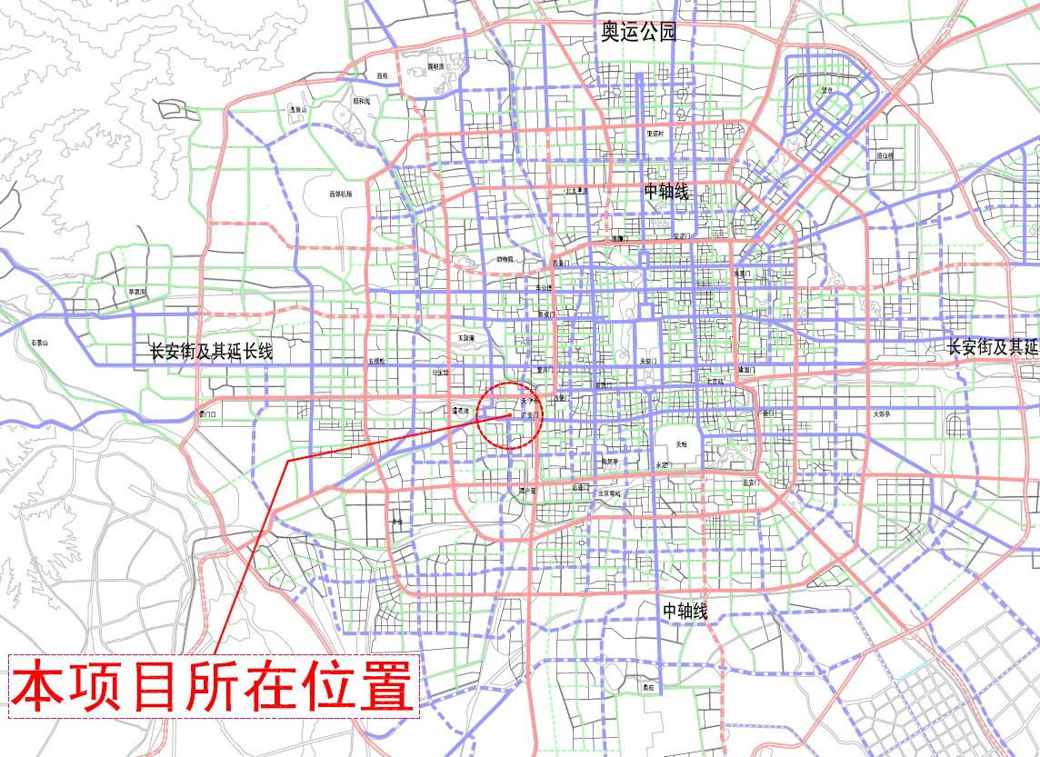
复兴门外大街
西三环中路
西二环中路
北
西
东
南
丽泽路

Slide 34
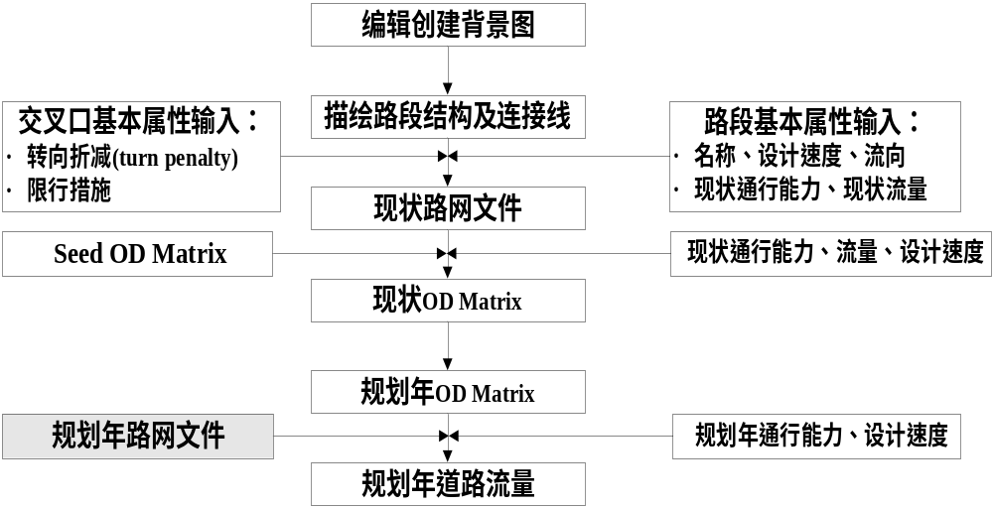
TransCAD —— 软件操作

Slide 35
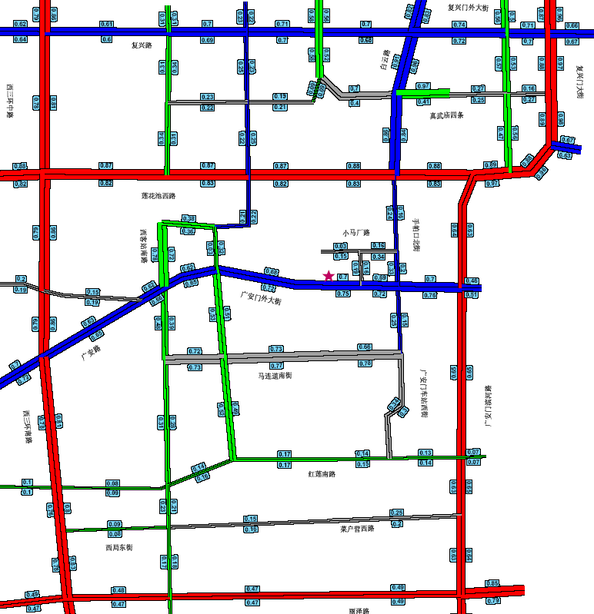
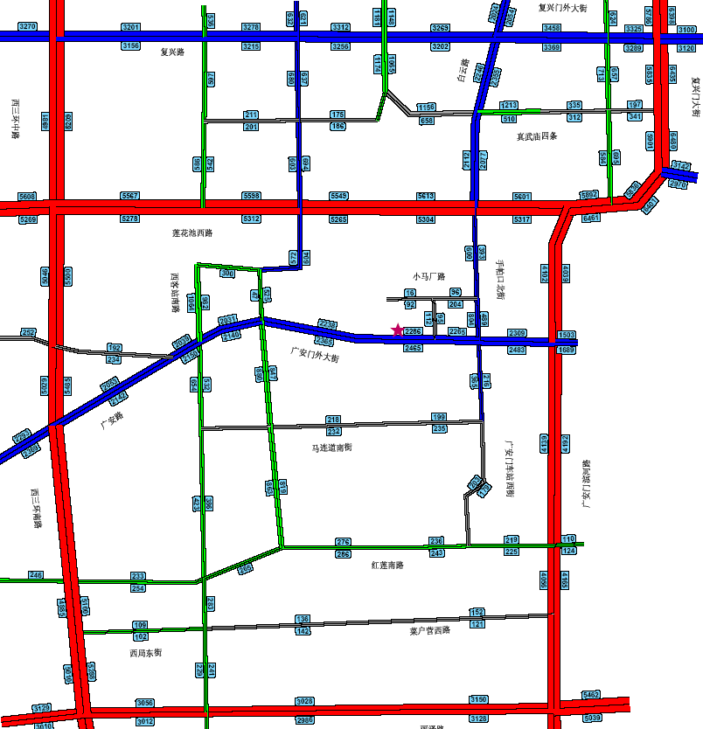
现状道路流量/负荷度
现状道路机动车高峰小时流量
现状道路机动车高峰小时负荷度

Slide 36
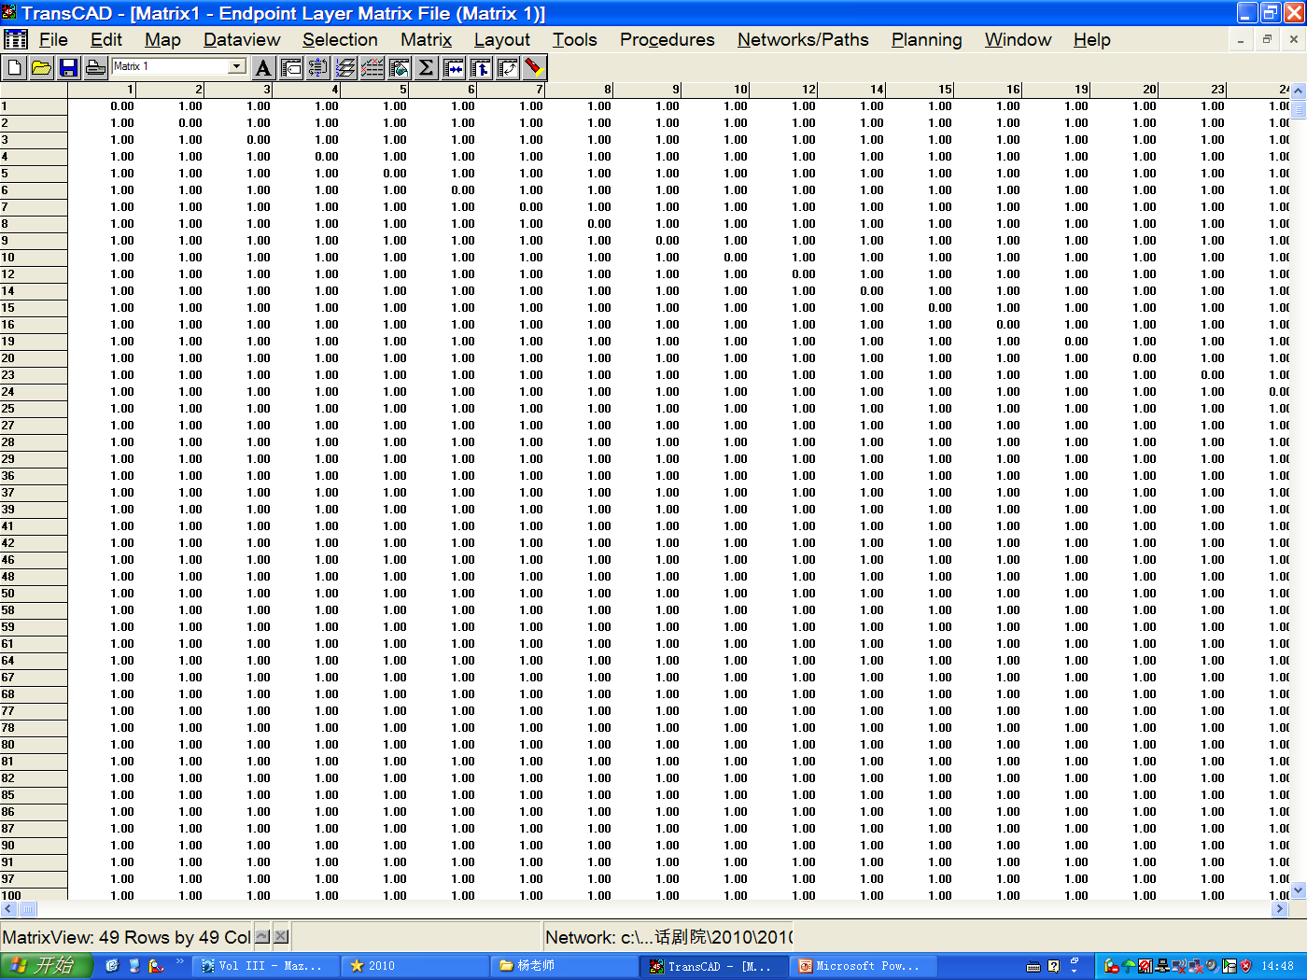

现状OD反推：

Slide 37
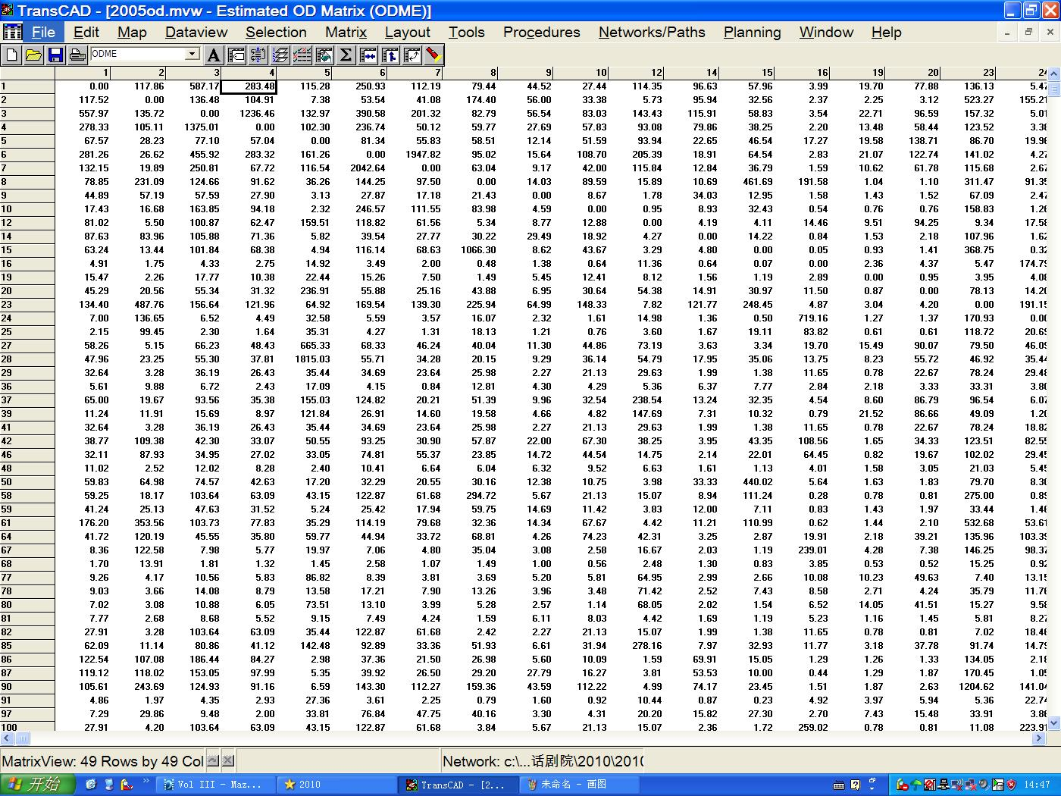
现状OD反推结果：

Slide 38
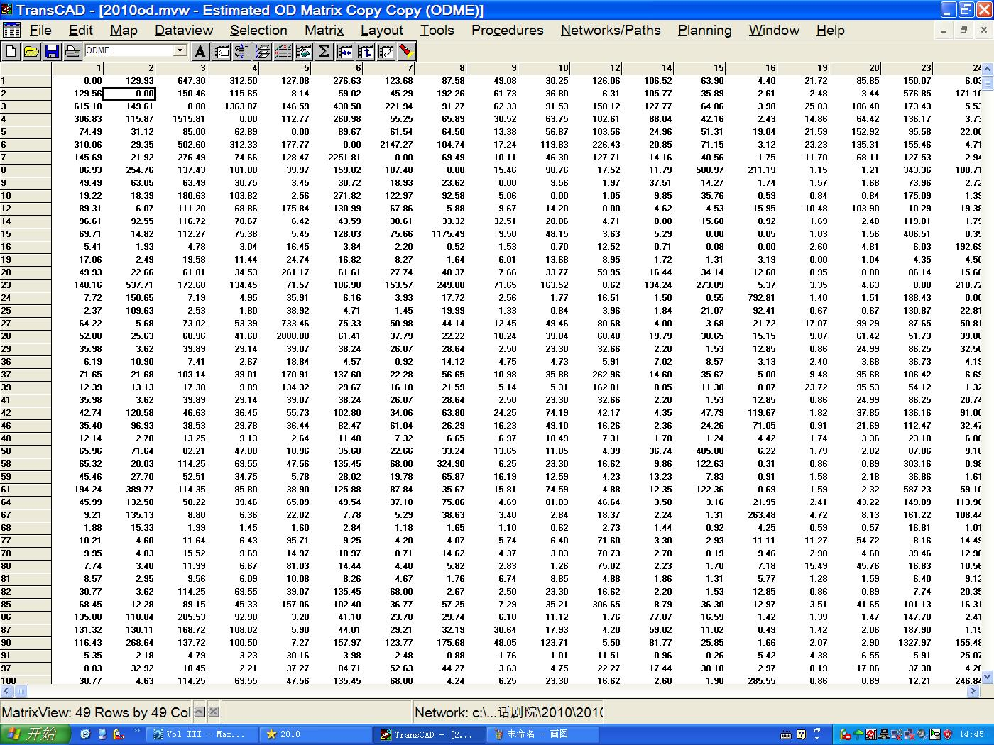
增长率预测未来OD

Slide 39
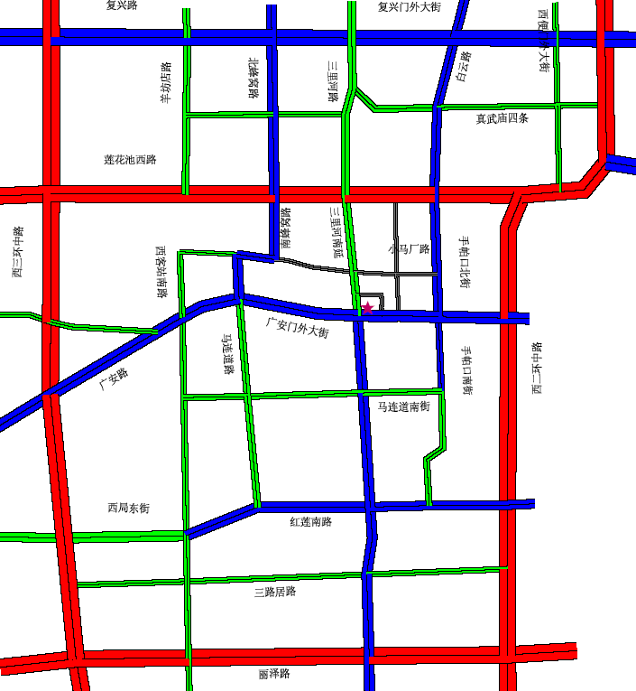

交通流分配：

Slide 40
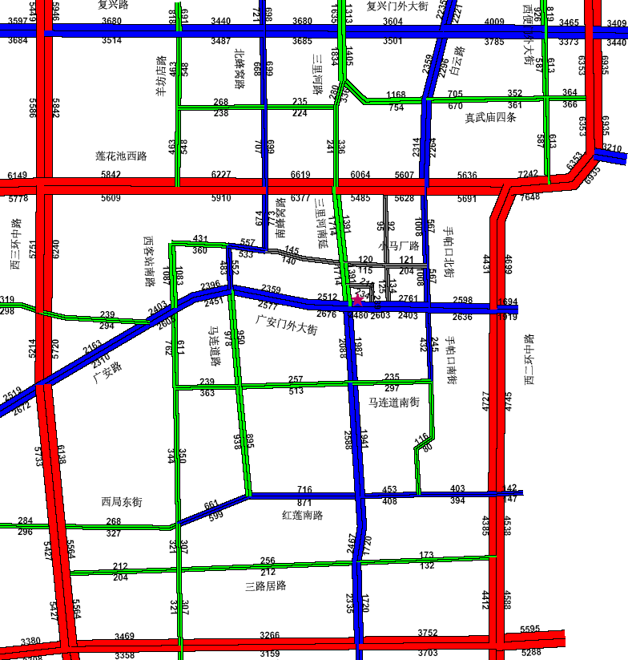
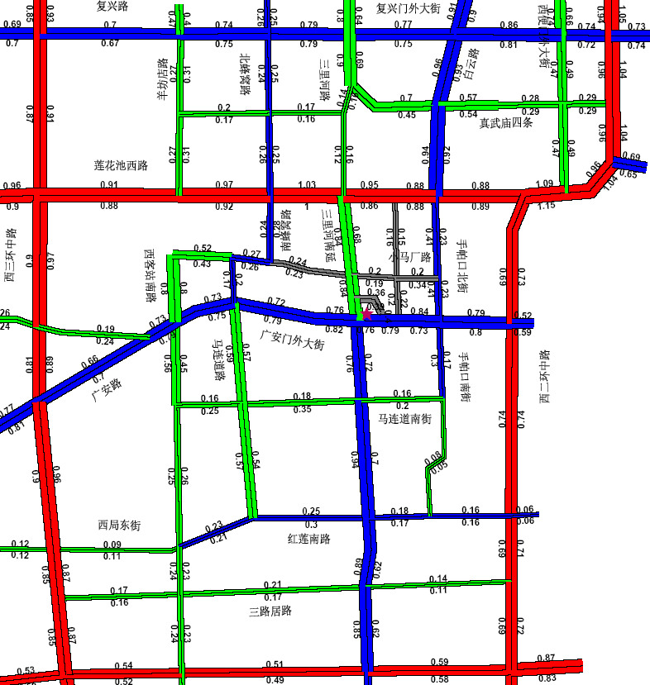
交通分配结果2010年流量/负荷度
2010年预测有项目交通量
2010年预测有项目交通负荷度

